Slide 1
A Project on Quora Question Pairs
Presentation by Group 2

Slide 2
Flow of Contents
Introduction
Problem description
Objective
Dataset
Steps involved
Data Cleaning
Data Processing
Modelling
Prediction
References

Slide 3

Introduction
About Quora
Platform to gain and share knowledge
Questions are asked, answered, edited and organized
Mutual and efficient learning
The best answer to any question
Notes:
Over 100 million people visit Quora every month, so it's no surprise that many people ask similarly worded questions. Multiple questions with the same intent can cause seekers to spend more time finding the best answer to their question, and make writers feel they need to answer multiple versions of the same question

Slide 4




Problem Description
Should I stay friend with a girl that rejected me?
with QQP
Similar questions
Same intent
Can a guy be friend with a girl after she rejects him?
More time to find app. answer
Results in answering multiple versions of similar Q’s
Creates duplicity
Will help Quora to show answers based on previously answered similar questions

Slide 5
Objective
To predict which of the provided pairs of questions have same meaning

Slide 6
Dataset
The Quora Question Pairs dataset is taken from Kaggle
Train data contains
40000+ question pairs
Total 6 parameters
id : the id of a training set question pair
qid1, qid2 : unique ids of each question
question1, question2 : the full text of each question
is_duplicate : the target variable, set to 1 if question1 and question2 have essentially the same meaning, and 0 otherwise.

Slide 7
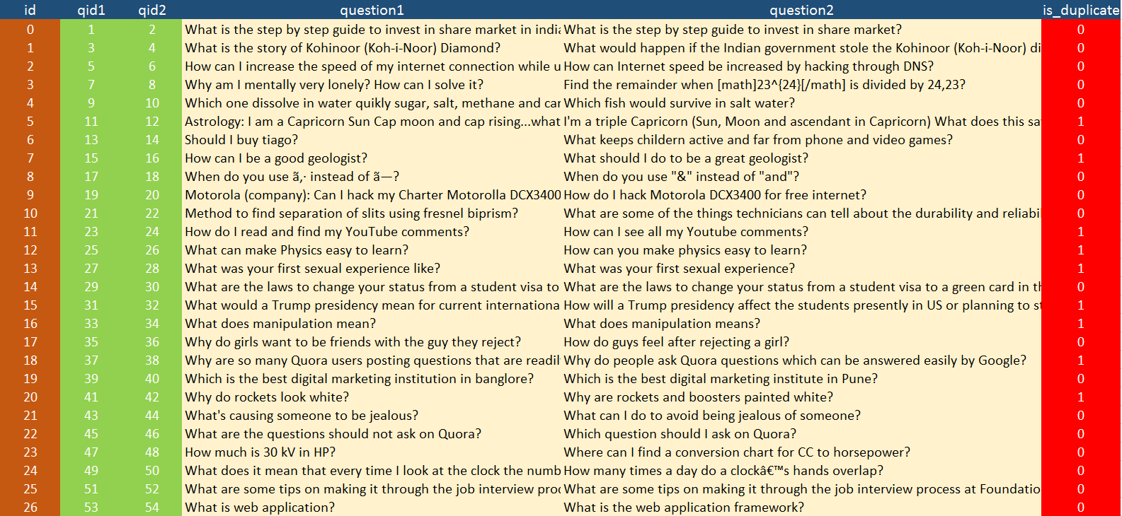
Sample Dataset

Slide 8
Steps involved
Data Cleaning
Stop word removal
Stemming
Data Processing/Input features selection
Cosine similarity
Common word ratio
Word count difference
Modelling
Random forest
Prediction
Validation & Test

Slide 9
Stop word removal
Refers to the most common words in language, such as “a", "the” are irrelevant
In order to make the process more effective, these words are dropped at the first phrase
Filtered out the stop words

Slide 10
Stemming
Process for reducing inflected words to their base form.
Process of Stemming

Slide 11
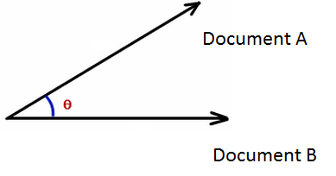
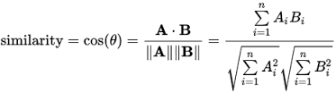
Cosine Similarity
Technique to measure how similar are two documents(sentences), based on the words they have.
If the two sentences have almost the same words then the cosine of
those vectors will be near to 1 otherwise this score will be close to 0.
Example: Q(1) What can make BA with R easy to learn?
Q(2) How can you make BA with R easy to learn?
Result is 0.843274 indicates these two sentences have almost the
same words
 | A | B
What | 1 | 0
Can | 1 | 1
Make | 1 | 1
BA | 1 | 1
With | 1 | 1
R | 1 | 1
Easy | 1 | 1
To | 1 | 1
Learn | 1 | 1
How | 0 | 1
You | 0 | 1

Slide 12
Common word ratio & Word count difference
CWR = Total number of common words / Total number of unique words
WCD = Difference between number of stem words in questions
Random Forest
An ensemble method that is a multitude of decision trees
Mode of the classes of individual trees determines the class of the output

Slide 13
Validation & Test
Training dataset : validation :: 70 : 30
AUC value for train dataset = 0.6730842
AUC value for validation = 0.674996
Inference : Good & efficient model
13

Slide 14
References
https://www.kaggle.com/c/quora-question-pairs
https://www.r-bloggers.com/text-mining-analysis-some-theory-and-practice-in-r/
https://eight2late.wordpress.com/2015/05/27/a-gentle-introduction-to-text-mining-using-r/

Slide 15

Thank you
Questions?

